Slide 1
IUNotifier Application Project Note – Sprint 2

Slide 2
Agenda
Release Note
Use case diagram
Getting courses information use case
Creating course announcements use case
Development Note
Version control
Sample Java source with refactoring
Test Note
Test case
JUnit test java source
Demo

Slide 3
Release Note

Slide 4
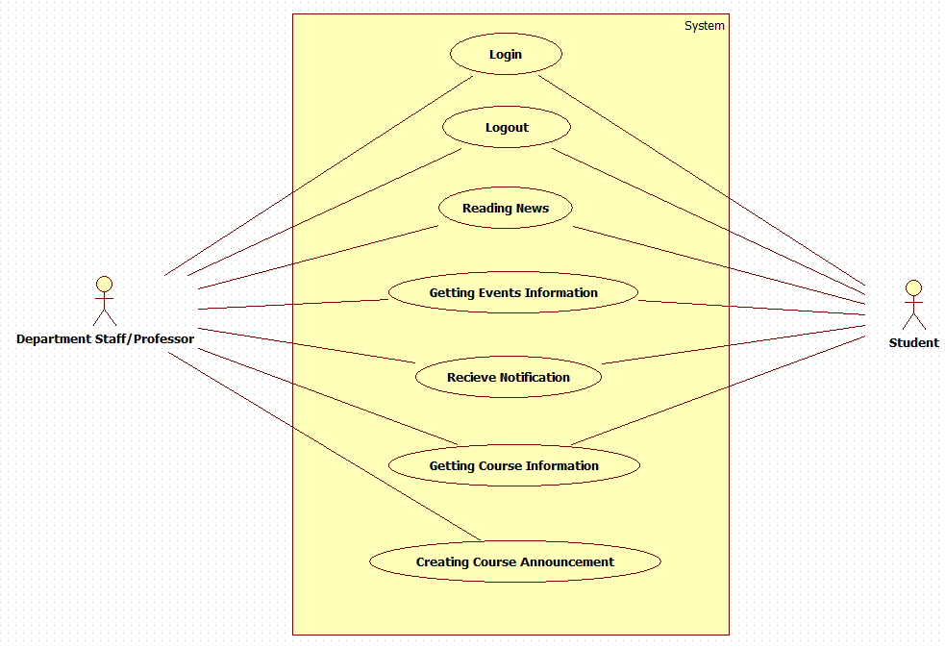
Use case diagram

Slide 5
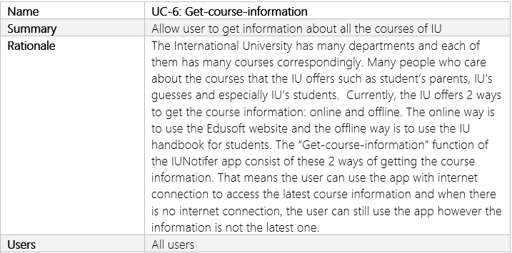
Getting courses information use case

Slide 6
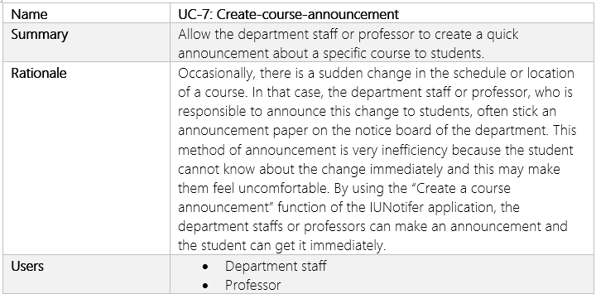
Creating course announcement use case

Slide 7
Development Note

Slide 8
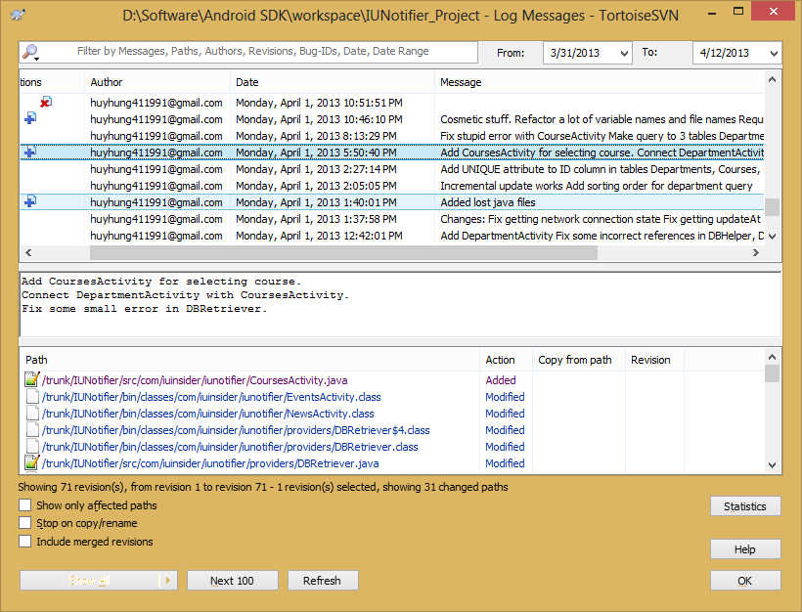
Version control Log message

Slide 9
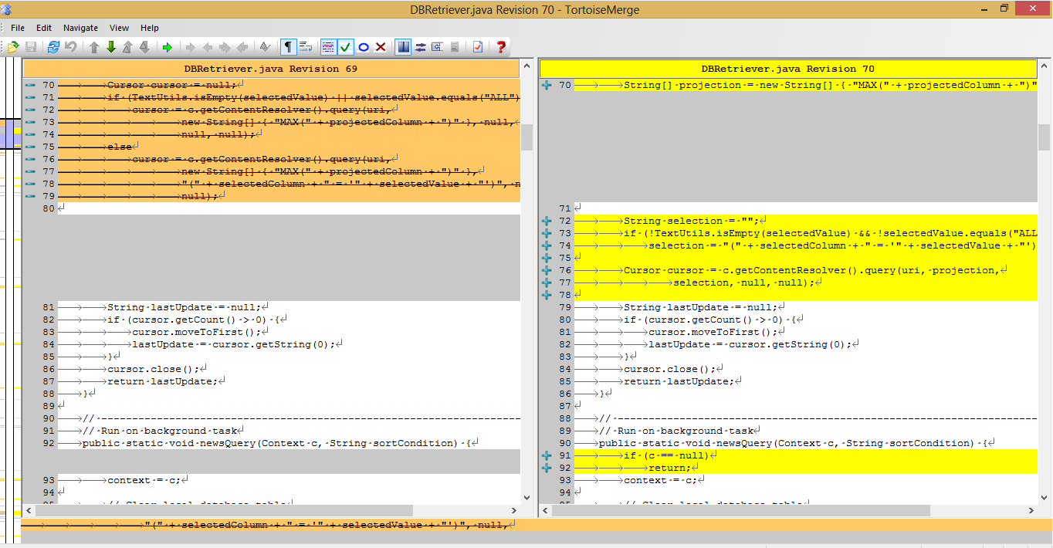
Version control Difference between 2 files

Slide 10
Refactoring
Replace magic number with symbolic constant

Slide 11
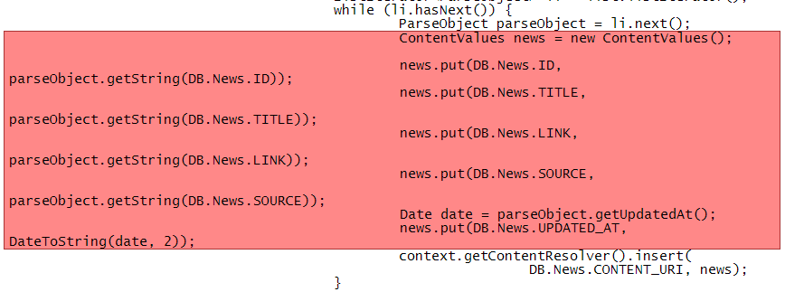
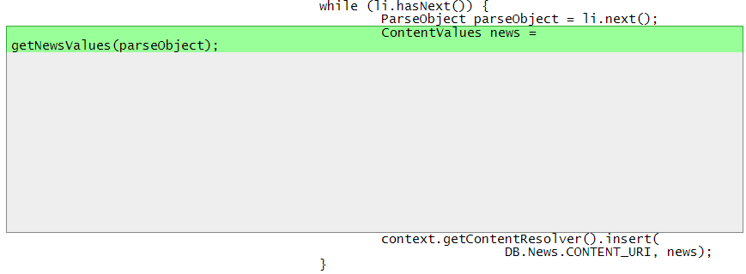
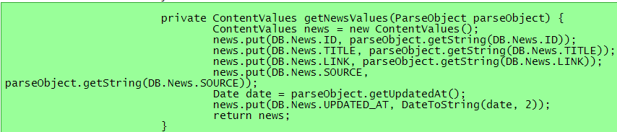
Refactoring
Extract method

Slide 12
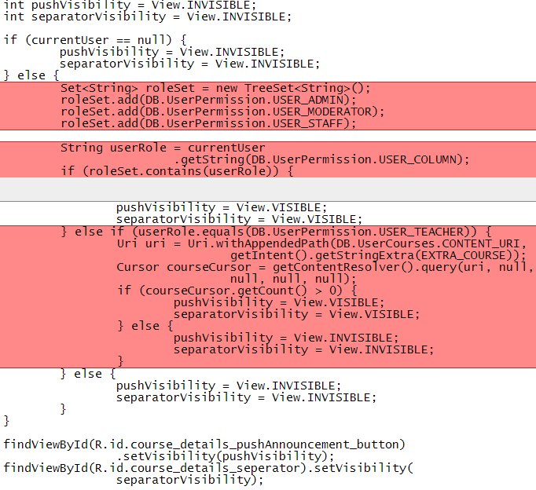
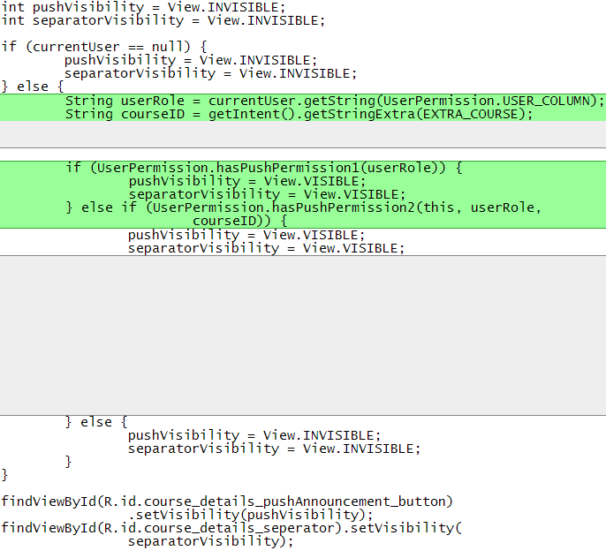
Refactoring
Decompose conditional

Slide 13


Refactoring
Split temporary variable

Slide 14
Test Note

Slide 15
Test case
Name | TC-01: Verify that the user can login with a correct username and a correct password
Requirement | FR-01: Login
Preconditions | The username itiu09008 and password 12345 must be available in the database.
Steps | Tap on the “Login” icon. Tap on the “Username” field. Enter itiu09008. Tap on the “Password” field. Enter 12345. Tap the “Sign in” button.
Expected Results | The login form dismisses. The “Login successfully” message displays. The “Login successfully” message dismisses. The color of the login icon changes to blue.

Slide 16
Test case
Name | TC-05: Verify that the user can logout off their current logging account
Requirement | FR-02: Logout
Preconditions | The user has logged in with the username itiu09008 and password 12345.
Steps | Tap on the “Logout” icon. Tap on the “Yes” button.
Expected Results | The logout-verification windows dismisses. The “Logout successfully” message displays. The “Logout successfully” message dismisses. The color of the login icon changes to white.

Slide 17
Test case
Name | TC-17: Verify that the user can get a list of studying courses
Requirement | FR-10: Get-studying-courses
Preconditions | The “Departments” page is loaded. The user has logged in with username itiu09008 and password 12345. The studying course of the user with username itiu09008 in the database must be “Software Project Management”.
Steps | Tap on the “My Courses” button.
Expected Results | The “Departments” page dismisses. The “Courses” page displays and the course list contains a “Software Project Management” course.

Slide 18
Test case
Name | TC-13: Verify that the user can get the detailed information of an event
Requirement | FR-06: Get-event-detail
Preconditions | The upcoming event list is loaded. The “BA Design Contest” event information must be available in the database.
Steps | Tap on the “BA Design Contest” event.
Expected Results | The detailed information windows displays. The “Description” field content is “Give your ideas to design the uniform and BA logo”. The “Date” field content is “Wednesday, 17-04-2013”. The “Time” field content is “08:00”. The “Location” field does not have anything.

Slide 19
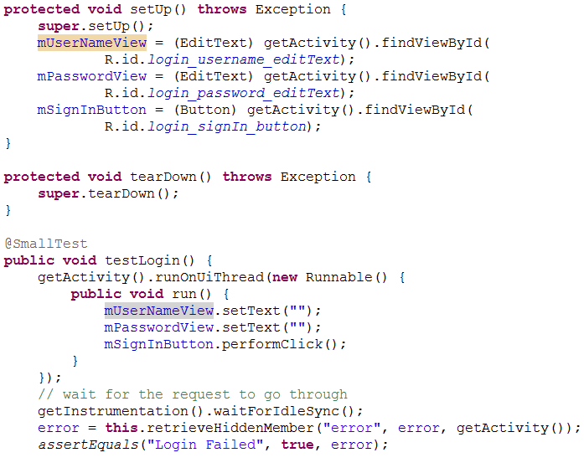
Junit Java source code

Slide 20
Demo

